Slide 1
Outline
Team (team work)
Mission statement (ways of working)
The size of the challenge and cost of solving it (user focus)
Ways of working (user focus, teamwork)
Where does the solution fit in the landscape (user focus)
How does it look (best solution, innovation)
Proof of concept, code (best solution, coding skills, innovation)

Slide 2


Notes:
We are team Buzz, where we mean BUZZINESS!

Slide 3

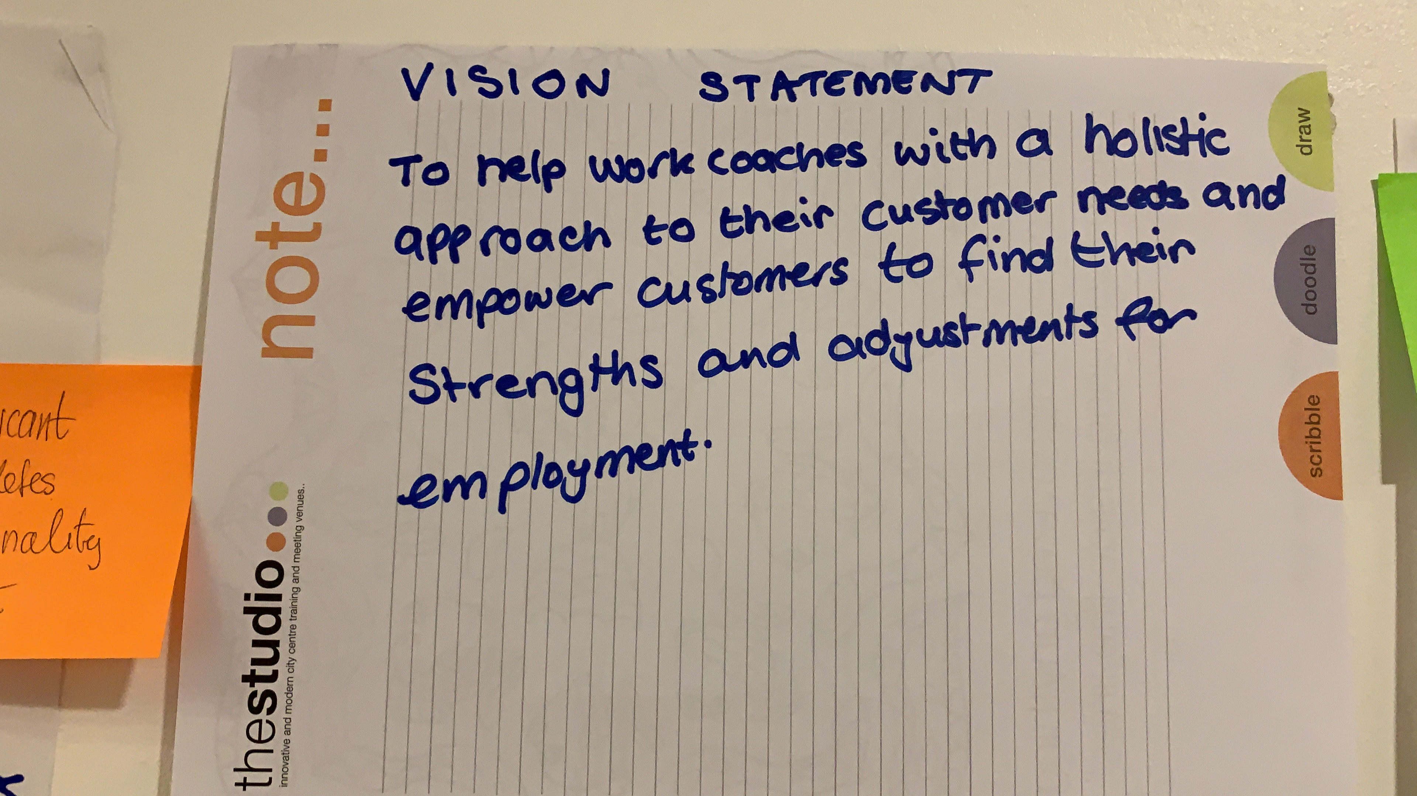
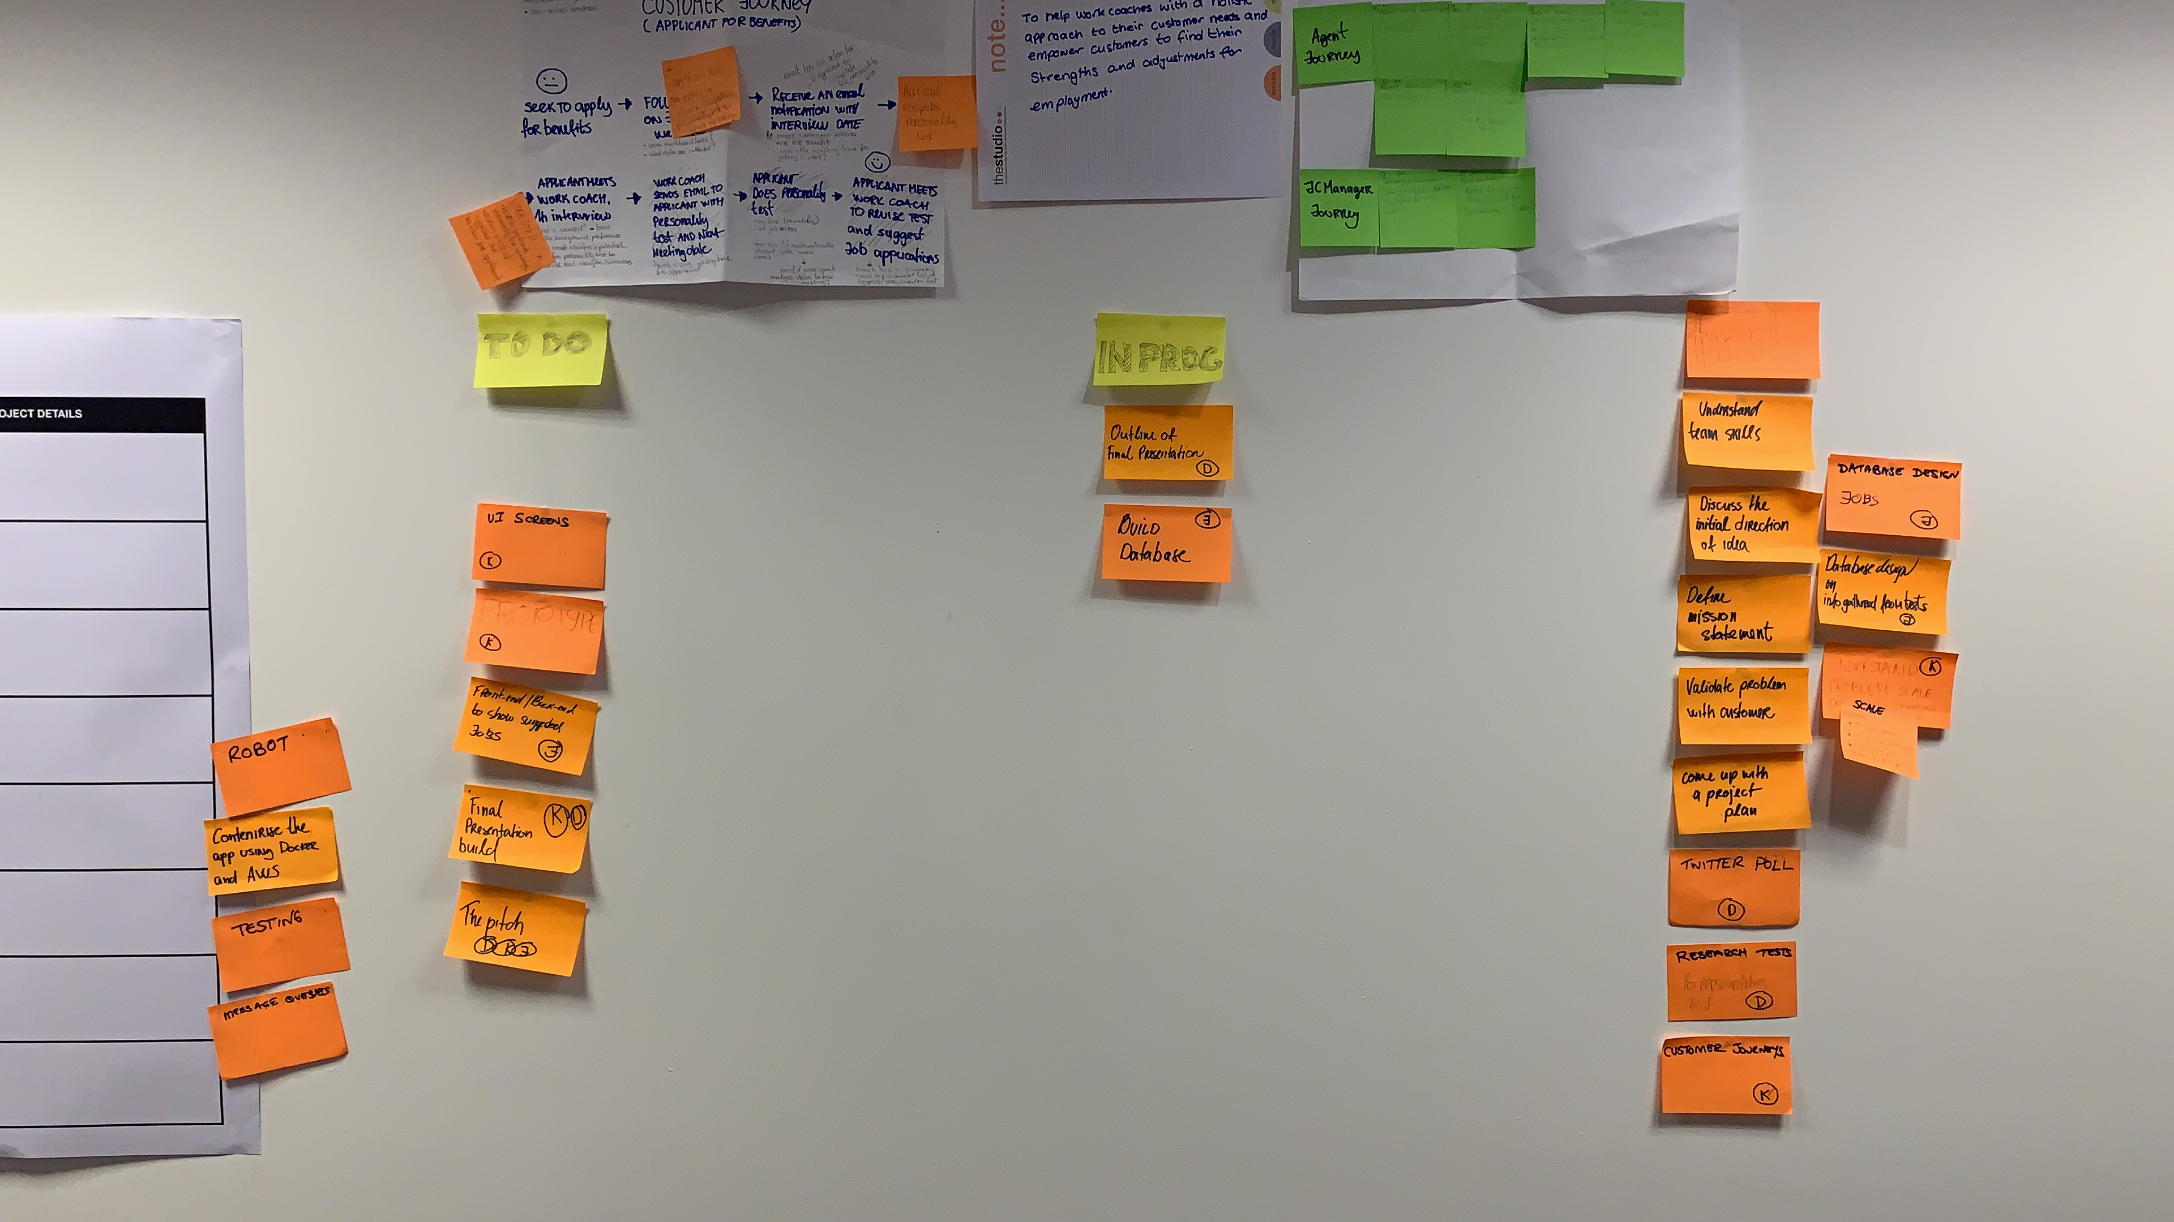
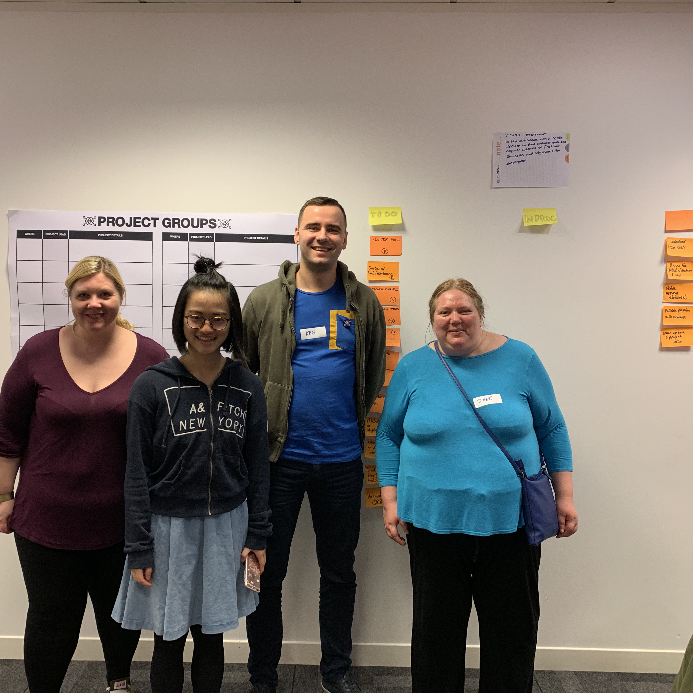
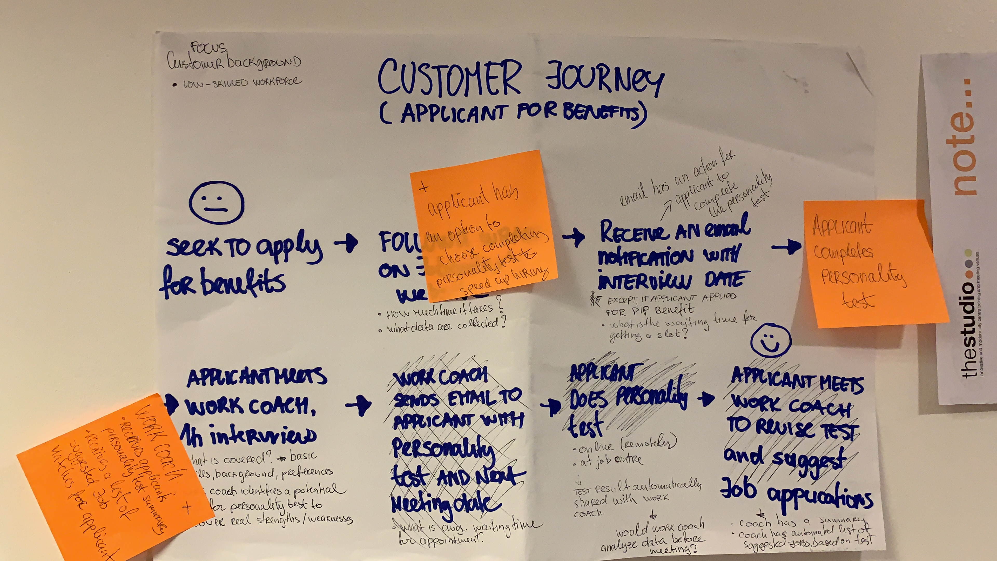
Diane Reddell
Software engineer and QA
JingMei
Freelancer, cloud platforms expert
Kristaps Romanovskis
Service designer
Terri Nichols
Support worker

Slide 4

To help Work Coaches with a holistic approach to their customer needs & empower customers to find their strengths & adjustments for employment

Slide 5
80 Work Coaches (just in Leeds city) Nationwide stats?
135 f2f interviews processed per month
45 min avg. interview duration (initial interviews + follow-ups)
Planning to ramp up capacity to 200+ interviews per month
X average number of sessions per applicant until successful placement?
X% on workforce retention in 3 months
Applicant satisfaction scores?
10.8k
INTERVIEWS PER MONTH
8.1k hours
SPENT EACH MONTH

Slide 6

What if we could…
Increase applicant satisfaction by X%
Release Work Coach time to meet 10% more applicants
Increase job placement success by X%
and more...
Notes:
Have a place for employers to recruit people with disability

Slide 7
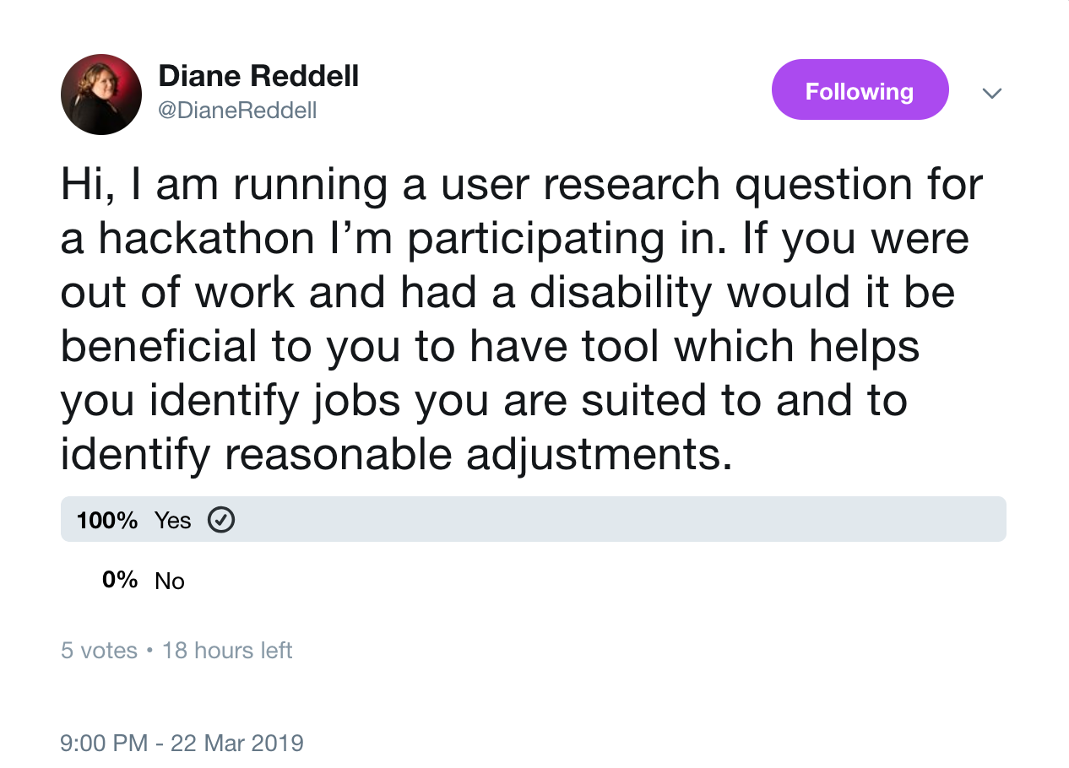
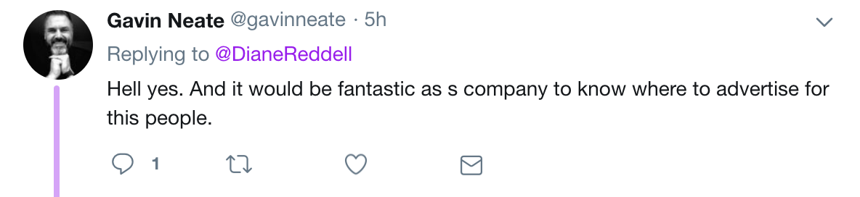
Nice idea… but what do Jobcentre experts, 3rd parties and applicants themselves think of it?
“If we could save Work Coach time, it would be very useful!”
– Jobcentre expert #1
“Yes, I would invest in this.”
– Jobcentre expert #2

Slide 8




How would it work for the applicant? (BRUTALLY SIMPLIFIED FLOW)
Apply for a benefit online and agree to take a personality test
Complete the personality test
WEB
Receive an email with interview date & personality test link
EMAIL
Work Coach interview. Personalised, characteristics based consultation on career path, preferences, strengths and necessary adjustments.
WORK COACH INTERVIEW
Personality test results passed to a Robot to analyze insights and cross-match potential best-fit vacancies.
ROBOT

Slide 9
Show me some
kudos

Slide 10
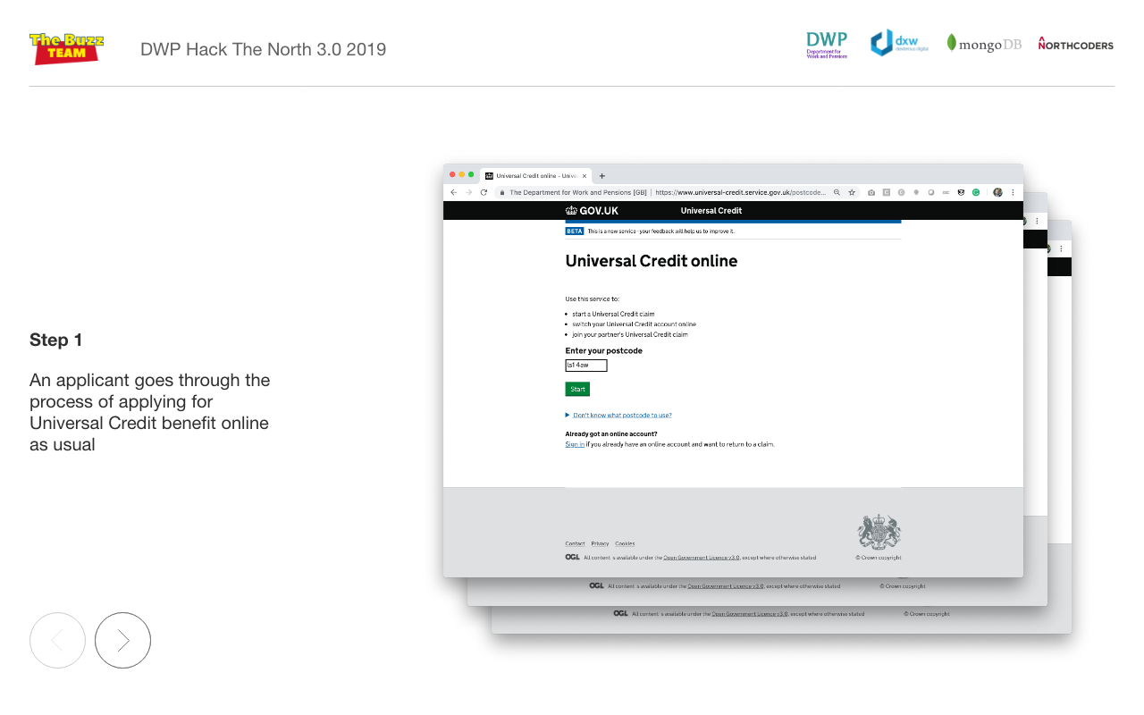

Slide 11
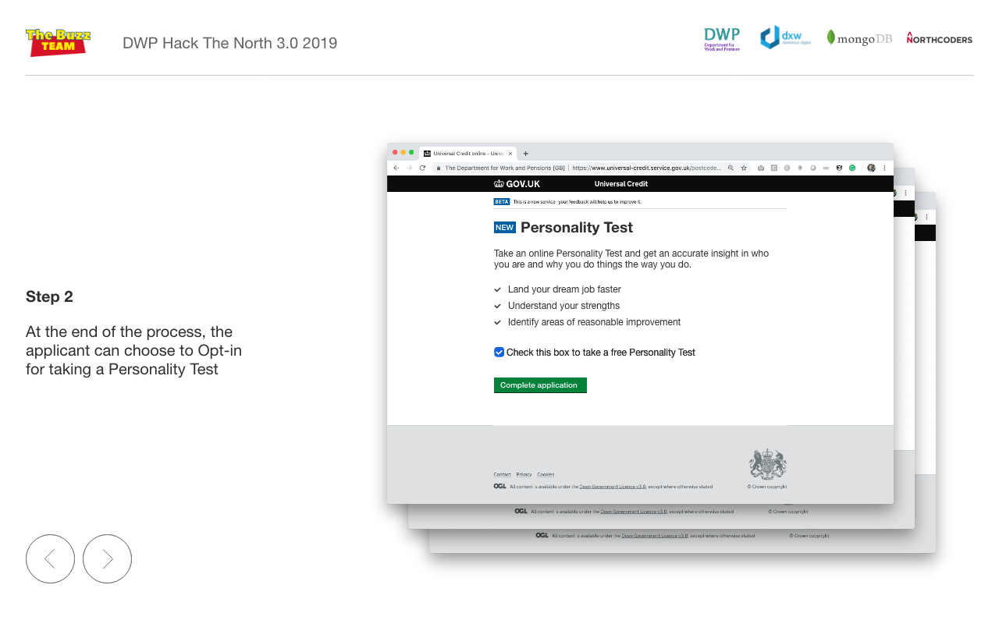

Slide 12
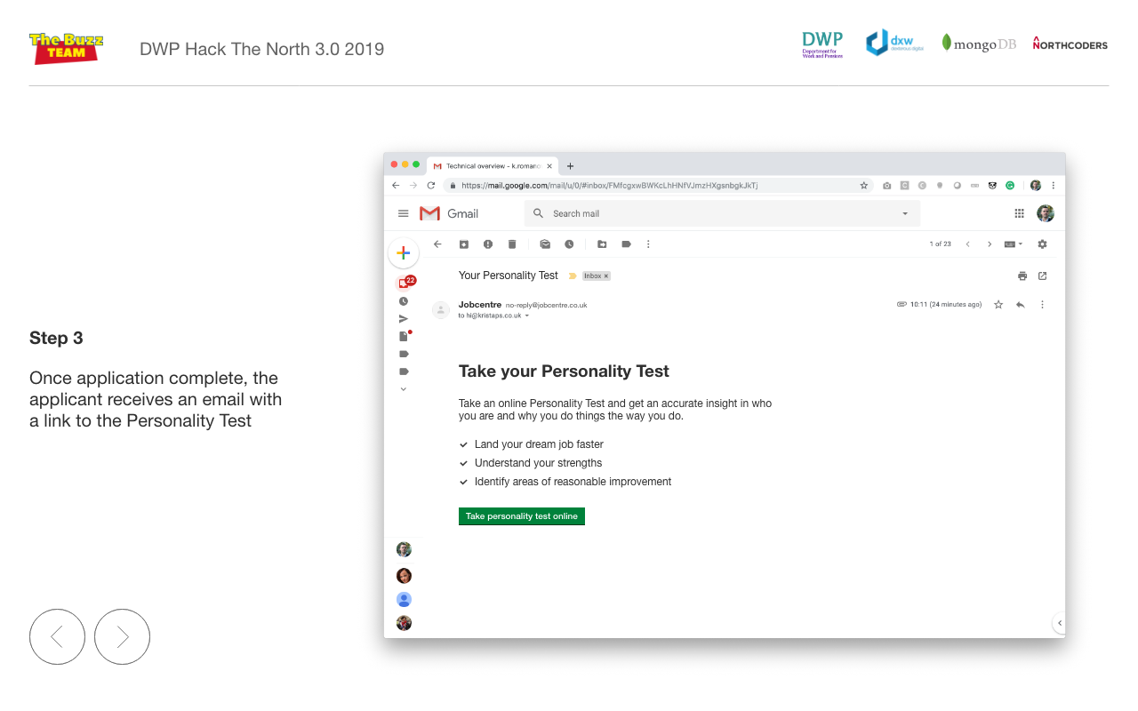

Slide 13
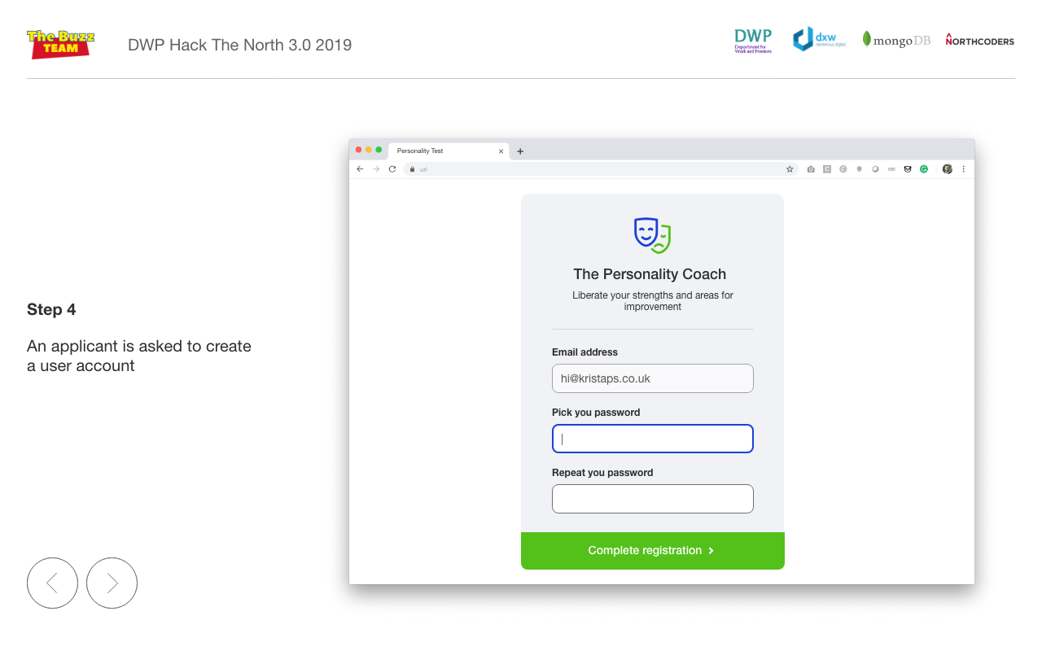

Slide 14
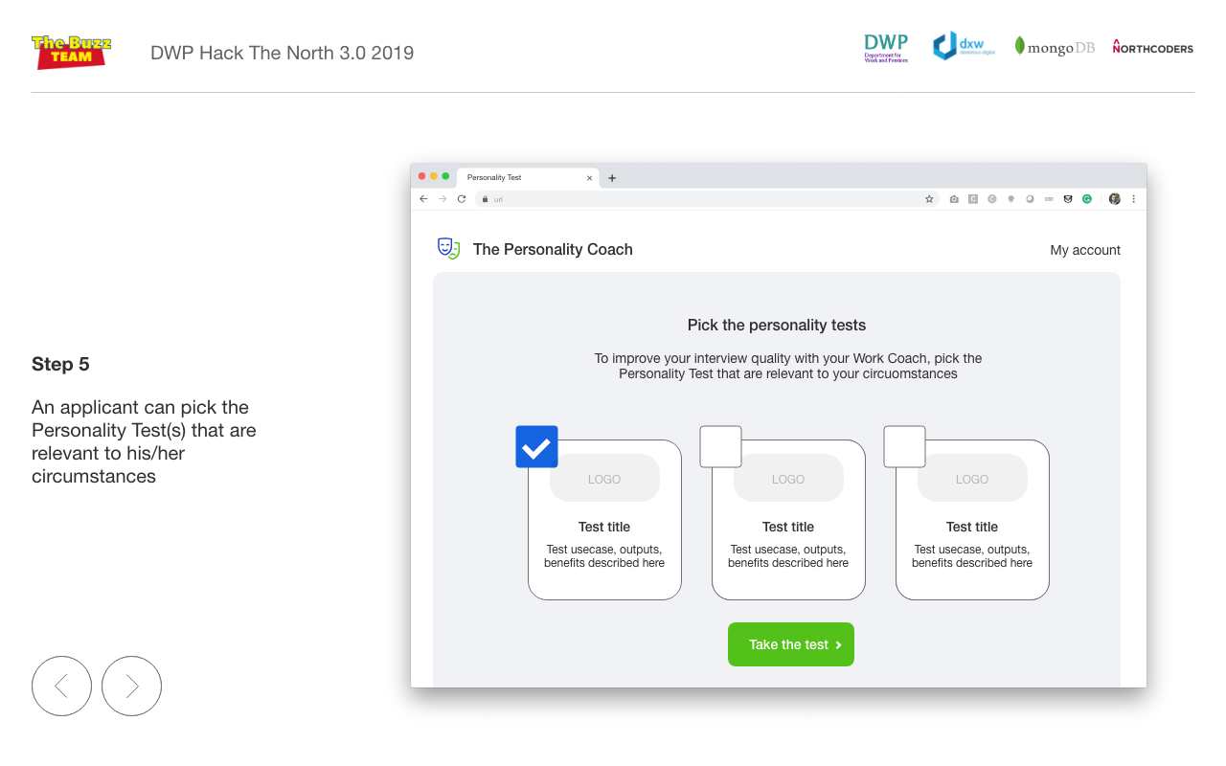

Slide 15
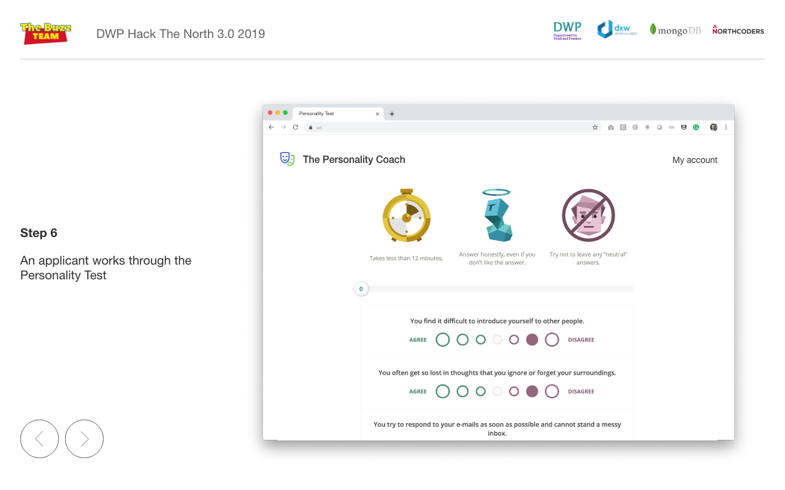

Slide 16
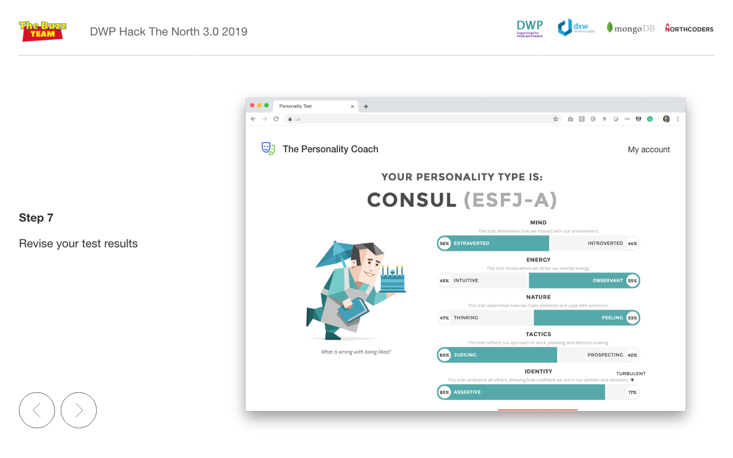

Slide 17
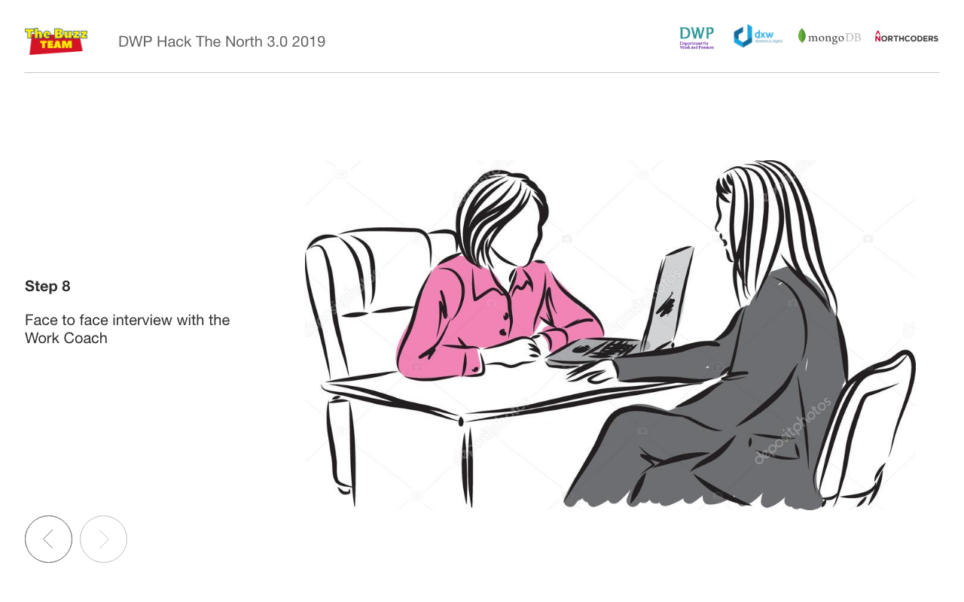

Slide 18
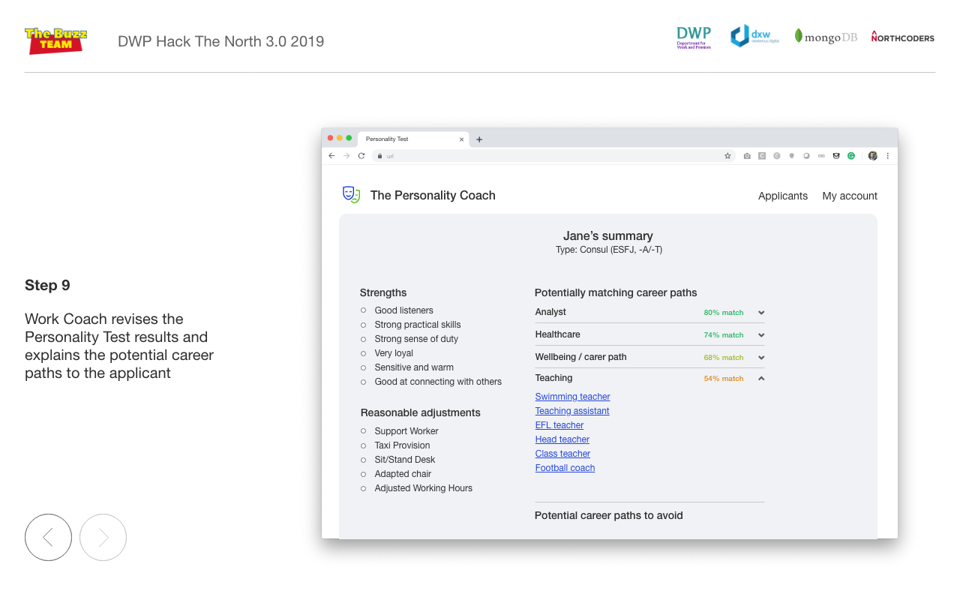

Slide 19
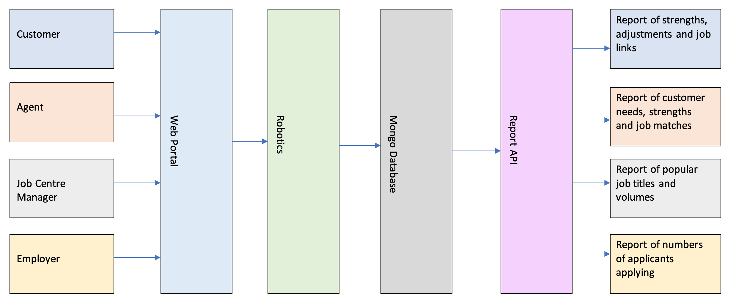
Technical overview
Hosted on AWS using Docker containers and S3 bucket to host the web portal. Secure login using Amazon Cognito.
Web portal – HTML, CSS, JQuery, Javascript
Robotics/Report API – Java and UIPath
Database – Mongo DB
Testing – Selenium/Cucumber, Axe-core, Pally, ZAP

Slide 20
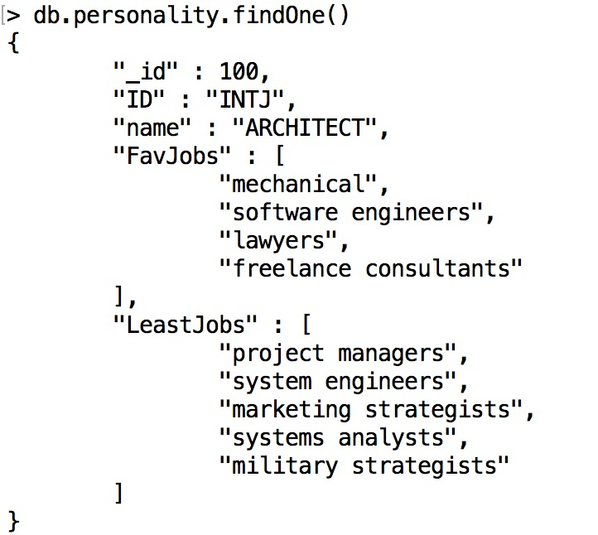
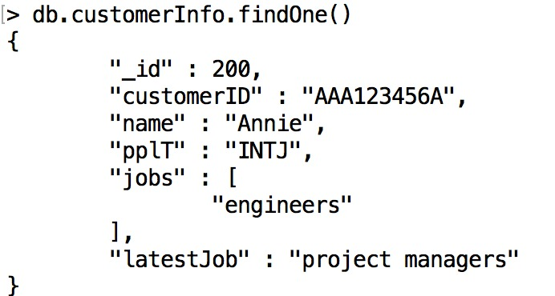
Lets unpack the database (work in progress code examples )
1. Establishing a personality table
2. Storing the customer personality record

Slide 21
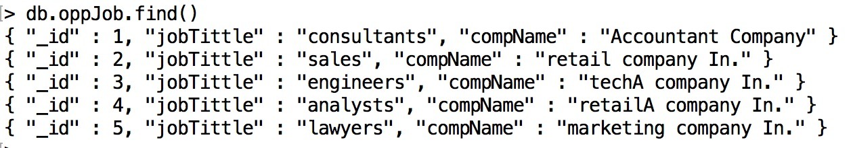
Lets unpack the database (work in progress code examples )
3. Matching the customer information with the job table

Slide 22
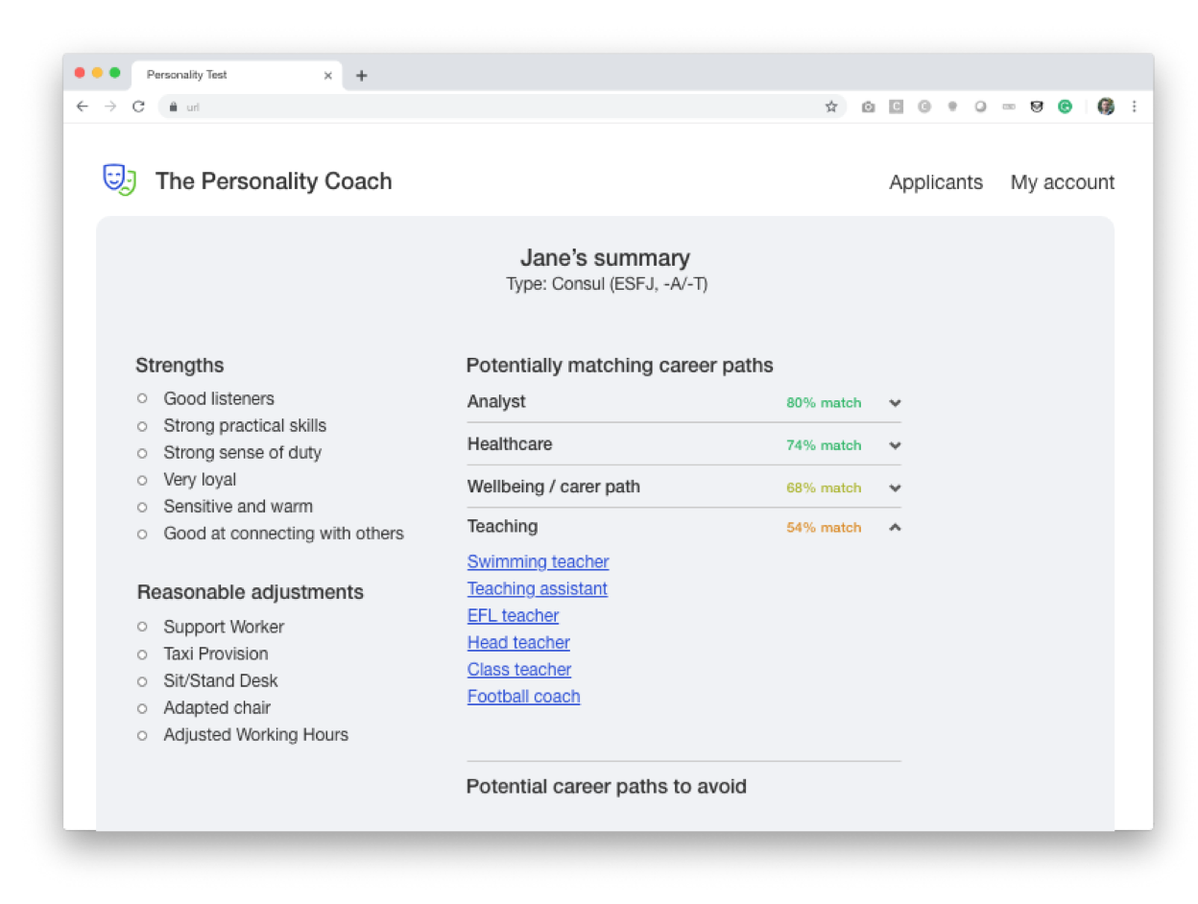
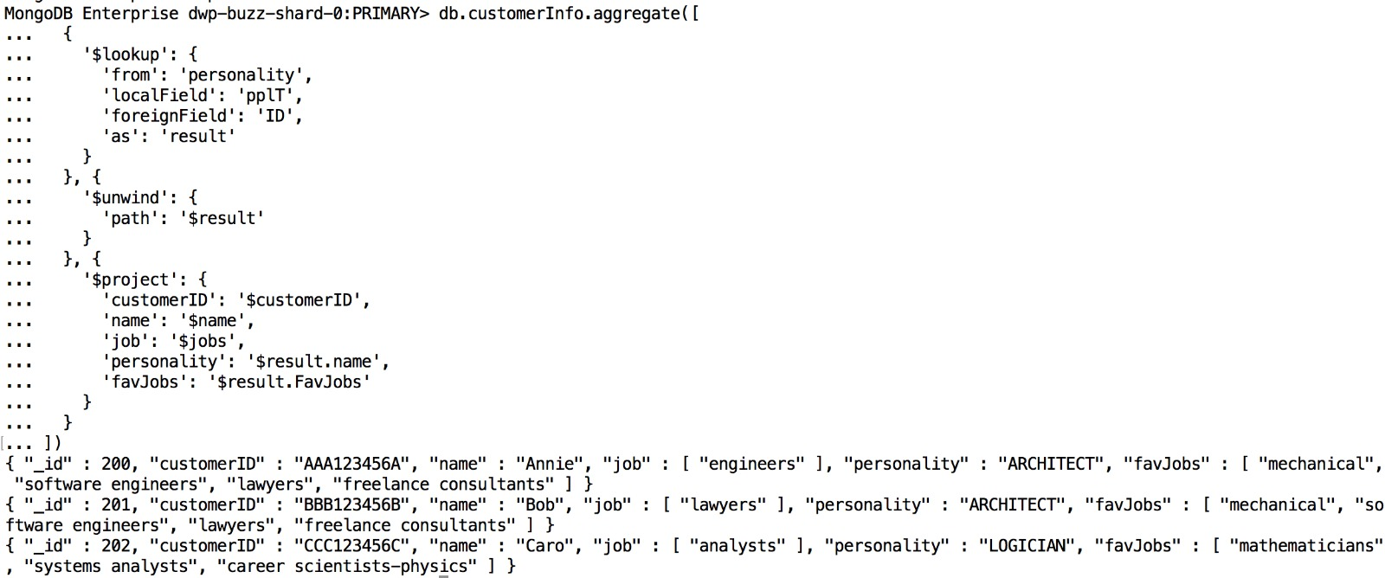
Lets unpack the database (work in progress code examples )
4. Output of the report results for the Work Coach and the Applicant

Slide 23
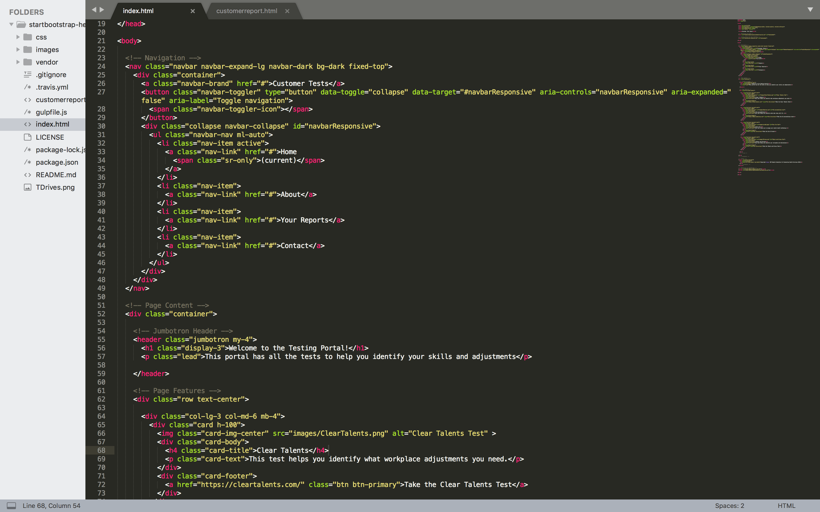
WIP Code

Slide 24
Expanding usecases and scaling
Job matching driven based on local job market
Supporting various personality tests to cater for wider audience…
Incorporate AI and machine learning into analysis of data for the solution in order to proactively help stakeholders to progress and develop
Helping with Local Enterprise Partnership reporting and investment strategies to create jobs for the local area specific to customer needs
Marketing of the tool with stakeholders to make them aware of the tool and its benefits of using it.
Containered solution for scaling as stakeholder numbers increase. This rationalizes the costs of using technology.
Reducing time and costs for stakeholder MI reports to allow stakeholders to identify where changes could be made.
Stakeholder satisfaction measures to help improve customer service

Slide 25


